Slide 1
Warm Welcome
Basic Statistics
( For BICTE Fifth Semester Students)
by
Dr. Lok Raj Sharma
Associate Professor of English & Head of the Faculty of Education
Makawanpur Multiple Campus
Hetauda, Makawanpur, Nepal

Slide 2
Types of Series
Individual Series | Discrete Series | Continuous Series
4, 6, 8, 9, 12 4.5, 6.5, 8.5 , 12.5 c. 5, 8, 16, r, 20 d. 1/5, 1 / 4, 1 /3, 1 /2 | Value Frequency 5 7 4 5 | Class Interval Frequency 0-10 5 10-20 7 20-30 6 30-40 3 ( Exclusive Continuous Series) Class Interval Frequency 0-9 5 10-19 7 20-29 6 30-39 3 ( Inclusive Continuous Series)

Slide 3
Measures of Central Tendency & Dispersion
Central Tendency | Dispersion
Measures of central tendency are statistical tools used to identify the central or typical value within a dataset. They help summarize a large set of data with a single representative value, giving an idea of where most values in the distribution lie. The three main measures of central tendency are: Mean : Average value Median: Middle Value Mode: Most frequently occurred value) | Measures of dispersion are statistical tools that describe the spread or variability of data values around a central point (like the mean or median). They help us understand how similar or diverse the data points are within a dataset. The three main measures of dispersion are: Range: The difference between the highest and lowest values. 2. Variance: The average of the squared differences from the mean. 3. Standard Deviation: The square root of variance.

Slide 4
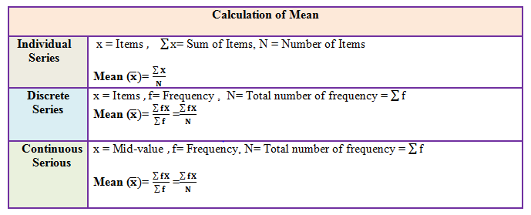
Mean
The mean is the sum of the value of each observation in a dataset divided by the number of observations. It is the most accurate measure of central tendency. This is also known as the arithmetic average.

Slide 5
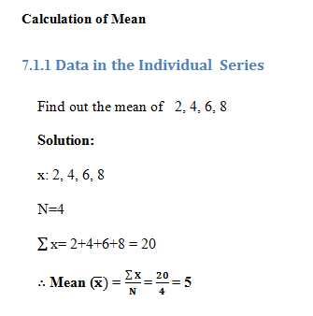
Mean

Slide 6
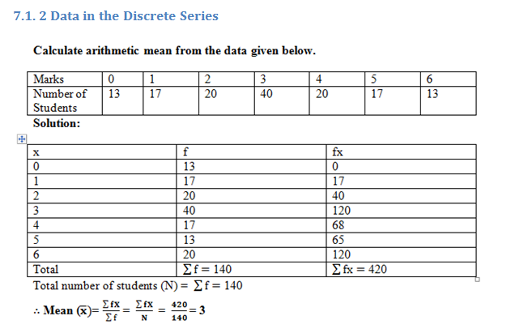
Mean

Slide 7
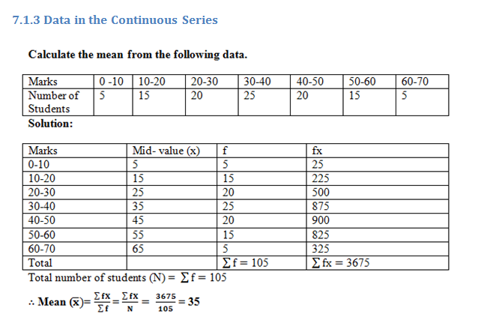
Mean

Slide 8
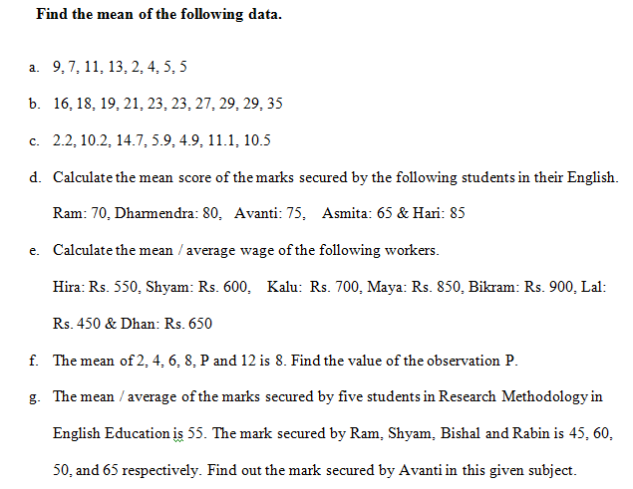
Practice-1

Slide 9
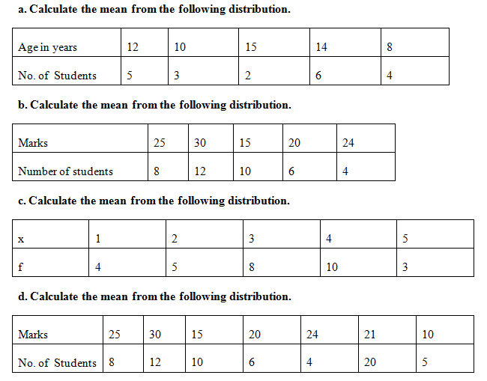
Practice-2

Slide 10
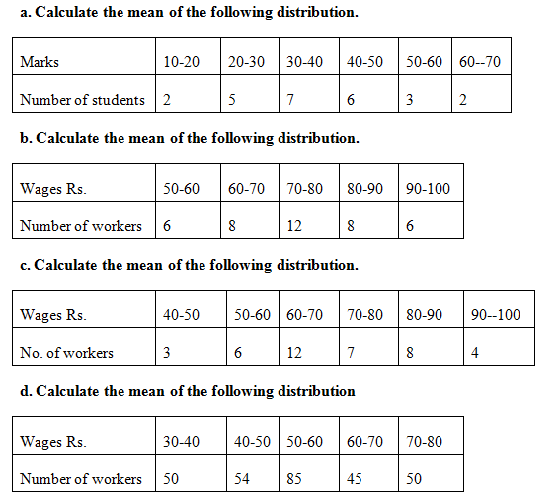
Practice-3

Slide 11
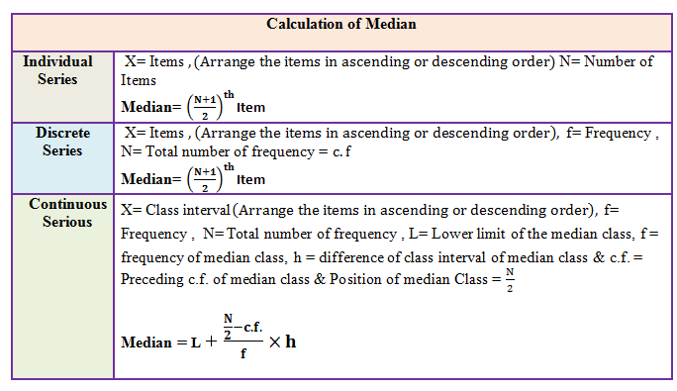
Median
Median is the middle value in distribution when the values are arranged in ascending or descending order. The median is a value which divides the series into two equal parts.

Slide 12
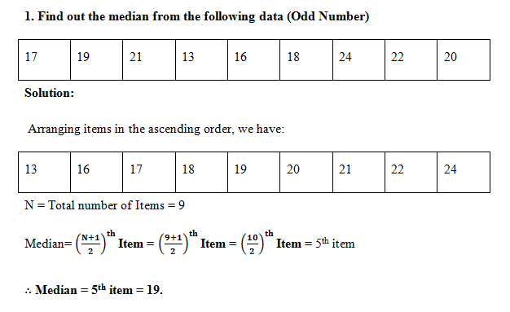
Median

Slide 13
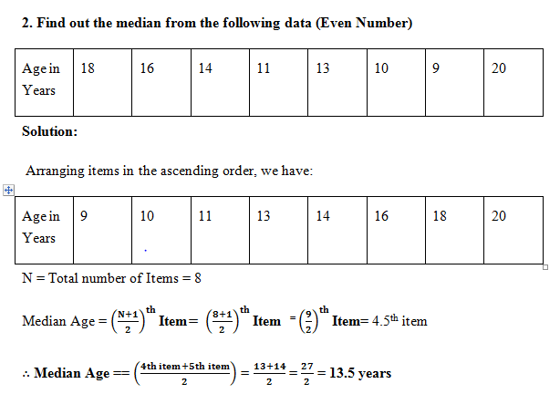
Median

Slide 14
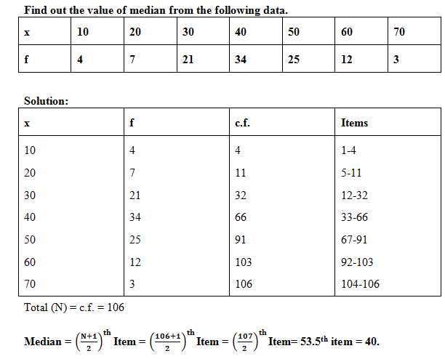
Median

Slide 15
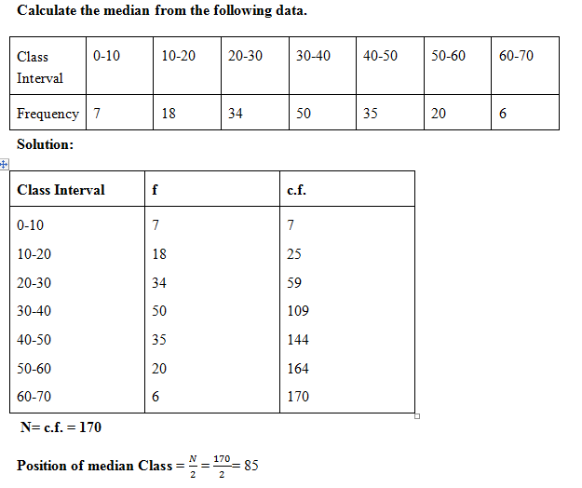
Median

Slide 16
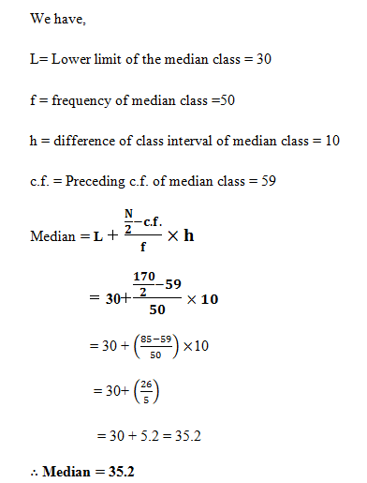
Cont.

Slide 17
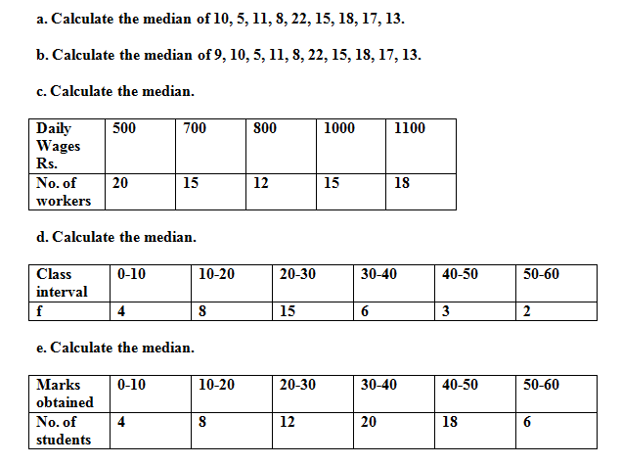
Practice

Slide 18
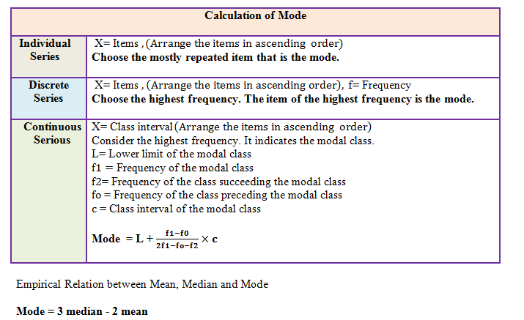
Mode
Mode is defined as the value that occurs most frequently in a statistical distribution. The mode is the least accurate measure for of central tendency.

Slide 19
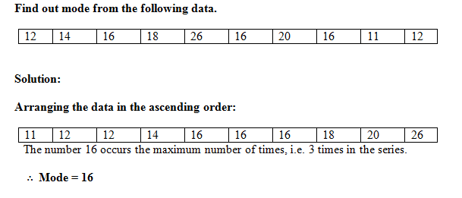
Mode

Slide 20
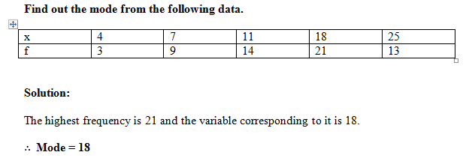
Mode

Slide 21
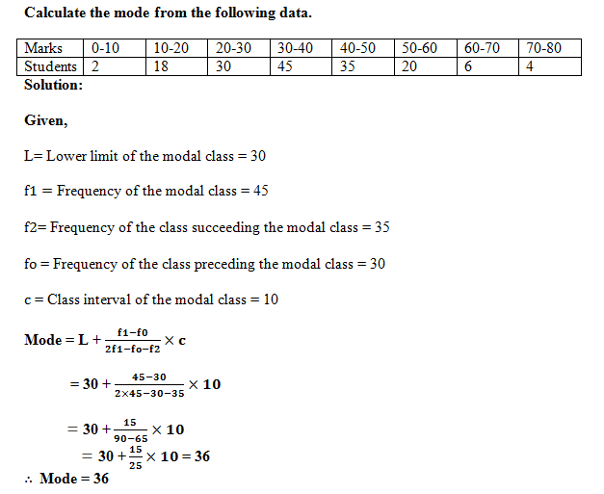
Mode

Slide 22
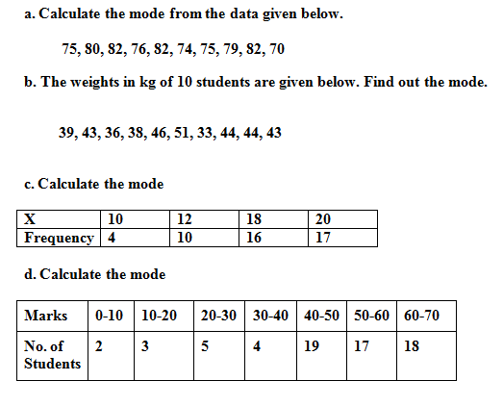
Practice

Slide 23
Most Accurate & Least Accurate
Measure | Most Accurate When… | Least Accurate When...
Mean | Data are normally distributed and without outliers | Data are skewed or have outliers
Median | Data are skewed or have outliers | Nominal/categorical data
Mode | Data are categorical or multimodal | Data are continuous or unimodal with no clear repetition

Slide 24
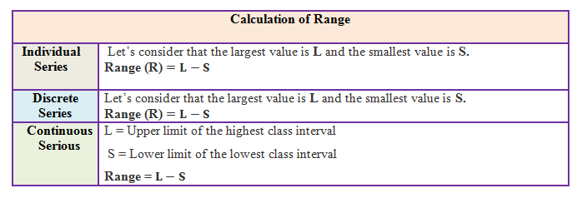
Range
The simplest measure of dispersion is the range. It is the least accurate measure of dispersion.
The range is the difference between the minimum and maximum values in a group of observations.

Slide 25
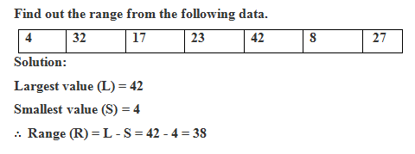
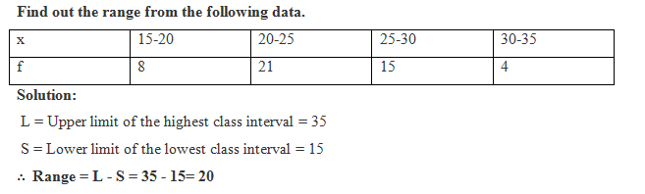
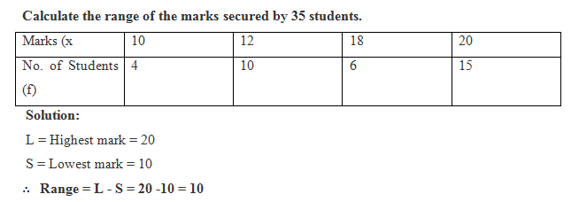
Range

Slide 26
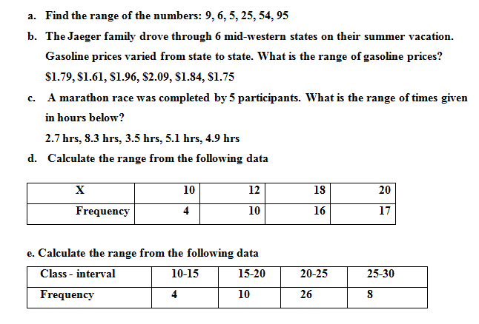
Practice

Slide 27
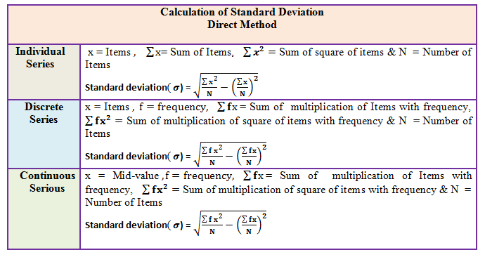
Standard Deviation
Standard deviation is the positive square root of the average of the square of the derivations of the measurements from their means. It is the most accurate measure of dispersion.

Slide 28
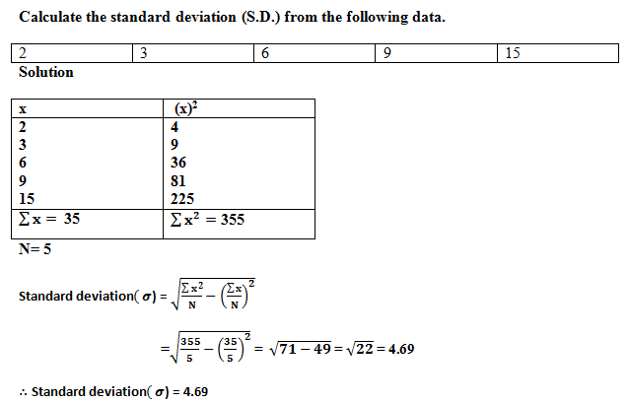
Standard Deviation

Slide 29
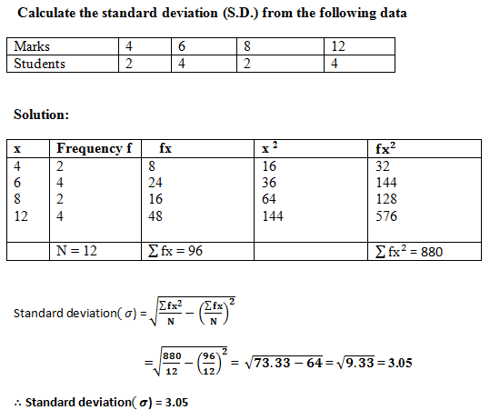
Standard Deviation

Slide 30
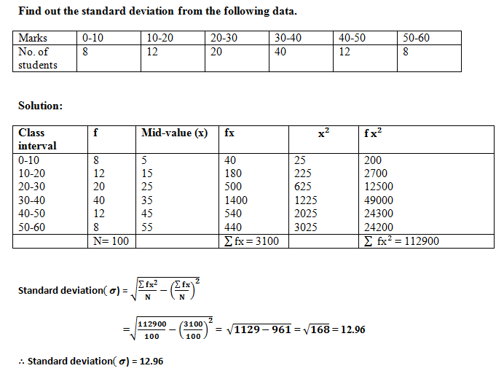
Standard Deviation

Slide 31
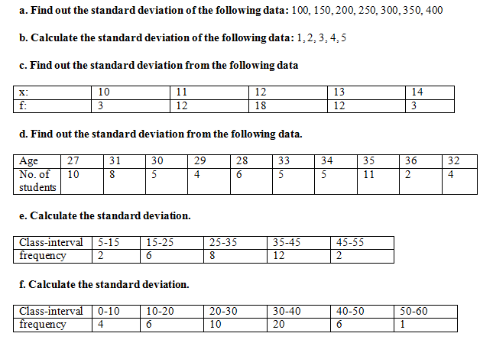
Practice

Slide 32
Most Accurate & Least Accurate
Measure | Most Accurate When... | Least Accurate When...
Standard Deviation | Normal data, no outliers | Skewed data, outliers
Interquartile Range (IQR) | Skewed data, outliers | Nominal/categorical data
Range | Quick estimate (but unreliable) | Data have outliers or large variability
Variance | Mathematical computations | Reporting (units are squared)
Mean Absolute Deviation (MAD) | Robust alternative to SD | Rarely used in formal stats

Slide 33
References
Bajracharya, D.R., Shrestha, R.M., Singh, M.B.,Sthapit, Y.R.,& Bajracharya, B.C. (2075). Basic mathematics. Kathmandu: Sukunda Pustak Bhawan.
Gupta, S. (2005). Research methodology and statistical techniques. New Delhi: Deep & Deep Publications PVT.LTD.
Gupta, S.C.,& Kapoor, V.K. (2000). Fundamentals of mathematical statistics (10th ed.). New Delhi: Sultan Chand & Sons.
Kenney, J. F., & Keeping, E. S. (1951). Mathematics of statistics, Part. 2 (2nd ed.). Princeton, NJ: Van Nostrand.
Press, W. H., Flannery, B. P., Teukolsky, S. A., Vetterling, W. T. (1992). Moments of a distribution: Mean, variance, skewness, and so forth. Numerical Recipes in FORTRAN: The Art of Scientific Computing, 14(1), 604-609.
Roberts, M. J., & Riccardo, R. A. (1999). Student's guide to analysis of variance. London: Routledge.
Sthapit, A.B., Yadav, R.S., Khanal, S.P., Baidar, P., & Amatya, P.B. (2017). Business statistics. Kathmandu: Ashmita Books Publishers and Distributors (P) Ltd.

